Slide 1
Pizza Sales Data Analysis Using SQL

Slide 2
Introduction
• This project focuses on analyzing the Pizza Sales dataset using SQL to understand business performance.
• It explores sales, orders, pizza categories, sizes, and revenue contribution.
• Interconnected tables such as Orders, Order_Details, Pizzas, and Pizza_Types simulate real-world sales workflows.
• SQL queries are used to extract, transform, and analyze sales patterns and performance metrics.
• The project strengthens concepts of database design, joins, normalization, and analytical SQL.
• Through analysis, insights are gained on revenue distribution, peak order times, and best-selling pizzas.
• The overall goal is to support business decisions using data-driven insights.

Slide 3

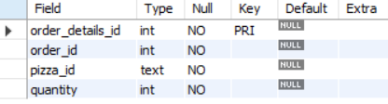
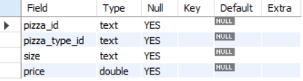
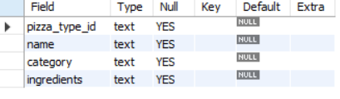
Tables
Orders Table Pizzas Table
Pizzas Table
Pizzas_type Table

Slide 4
Problem Statement
• Pizza businesses generate large amounts of daily sales data across orders, products, and pricing.
• Without proper analysis, identifying best-selling pizzas or peak demand hours becomes difficult.
• Manual review of data leads to inefficiency and incorrect revenue tracking.
• The business needs an SQL-driven system to analyze pizza demand, revenue distribution, and product performance.
• SQL queries help visualize patterns, compare product categories, and understand customer demand behavior.

Slide 5
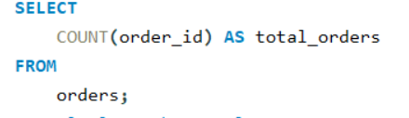

1. Retrieve the total number of orders placed

Slide 6
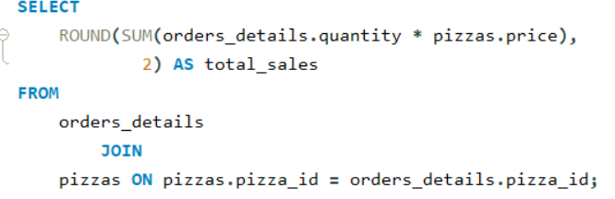

2. Calculate the total revenue generated from
pizza sales

Slide 7
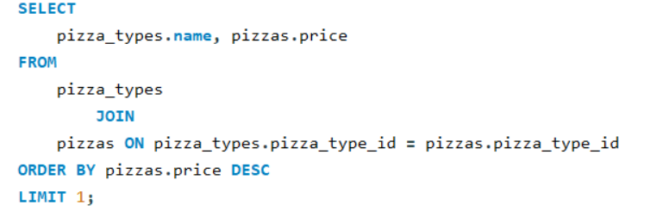

3. Identify the highest-priced pizza.

Slide 8
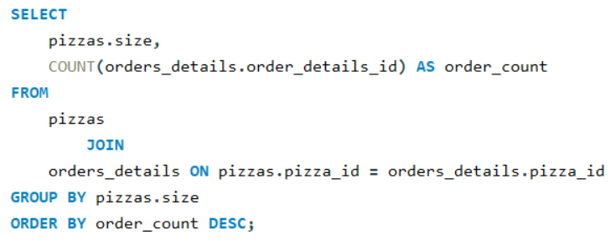
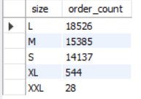
4. Identify the most common pizza size ordered

Slide 9
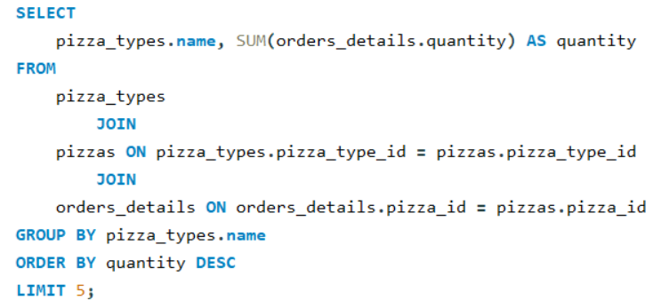
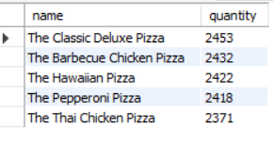
5. List the top 5 most ordered pizza types along with their quantities.

Slide 10
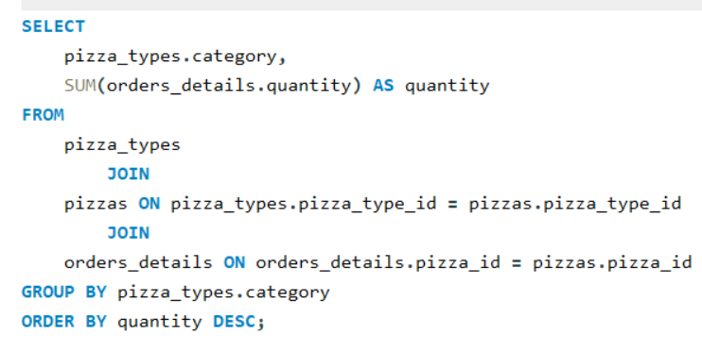
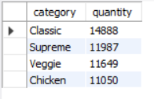
6. Join the neccessary tables to find the total quantity of each pizza category ordered.

Slide 11
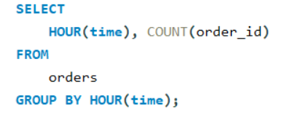
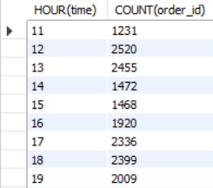
7. Determine the distribution of orders by hour of the day

Slide 12
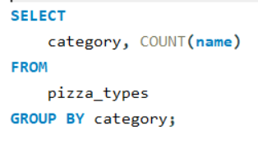
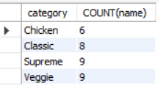
8. Join relevant tables to find the category wise distribution of pizzas.

Slide 13
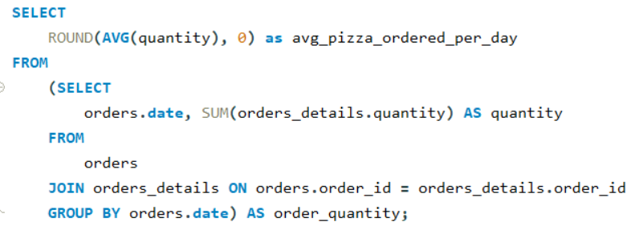

9. Group the orders by date and calculate the average number of pizzas ordered per day

Slide 14
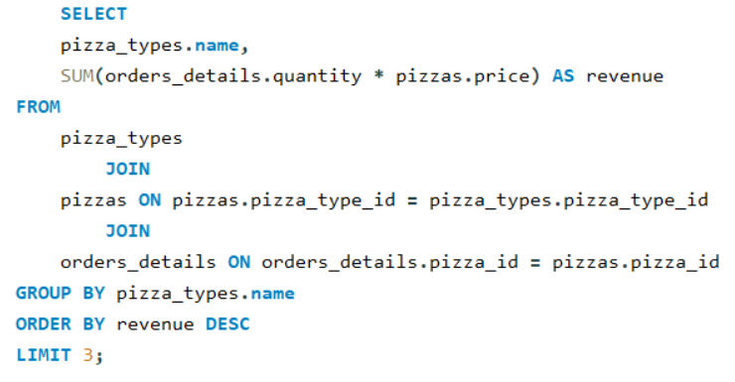
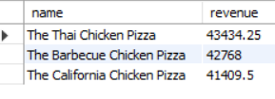
10. Determine the top 3 most ordered pizza types based on revenue.

Slide 15
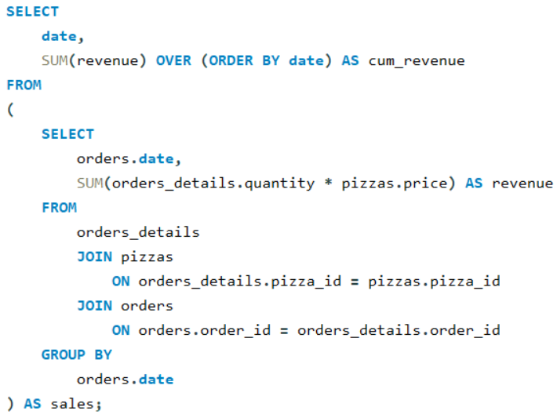
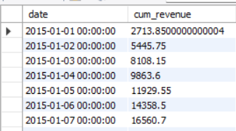
11. Calculate the percentage contribution of each pizza type of total_revenue.

Slide 16
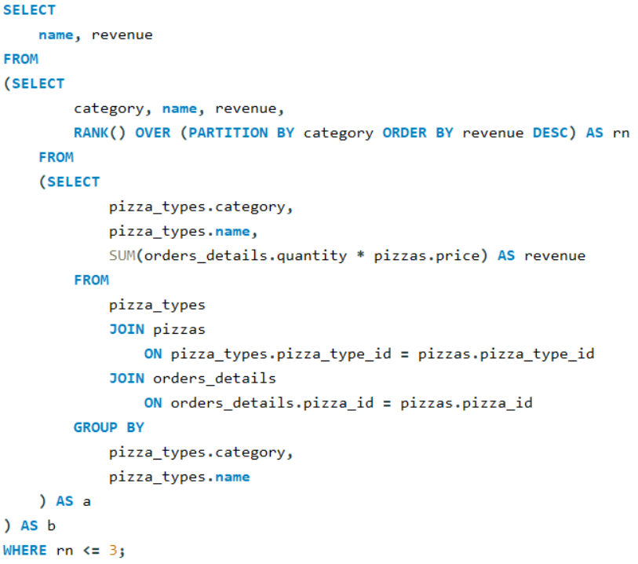
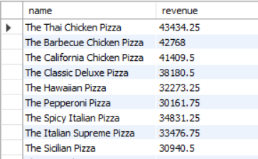
12. Determine the top 3 most ordered pizza types based on revenue for each pizza category.

Slide 17
Key Insights
• Peak Ordering Hours: Orders increase significantly during lunch and dinner hours.
• Category Performance: Categories such as Classic and Supreme generate the highest revenue.
• Best-Selling Items: A few pizza types dominate the total orders and revenue.
• Size Preference: Medium and Large pizzas are ordered more frequently.
• Revenue Trends: Cumulative revenue shows consistent growth over days.
• Top Earners: Certain pizzas deliver disproportionate revenue, guiding promotional decisions.

Slide 18
Recommendations
• Promote high-selling pizzas and create combo offers to increase sales.
• Maintain optimal stock of popular pizza categories and sizes.
• Introduce discounts during non-peak hours to boost overall order volume.
• Improve pricing strategy for premium pizzas to increase revenue share.
• Continue SQL-based tracking of weekly/monthly trends to support future decisions.

Slide 19
Conclusion
• The SQL-based Pizza Sales Analysis provides a complete view of sales performance.
• Insights help improve decision-making, marketing strategies, and customer satisfaction.
• Analytical SQL techniques such as Window Functions and CTEs enhanced the depth of insights.
• The project demonstrates strong SQL skills and the ability to convert raw data into actionable insights.

Slide 20
THANK
YOU

